Slide 1
HTTP
HTTP (Hypertext Transfer Protocol) is an application layer protocol that allows web based application to communicate and exchange data,
It is the set of rules for transferring files, such as text, graphic images, sound, video, and other multimedia files, on the World Wide Web between two computers,
It provides standard between web browser and server to communicate,

Slide 2
As soon as a Web user opens their Web browser, the user is indirectly making use of HTTP,
main standard that controls how the World Wide Web works is HTML, which covers how Web pages are formatted and displayed,
HTTPS means Hypertext Transport Protocol, is the secure version of HTTP,
HTTPS is the use of Secure Sockets Layer (SSL) or Transport Layer Security (TLS) as a sublayer under regular HTTP application layering,

Slide 3
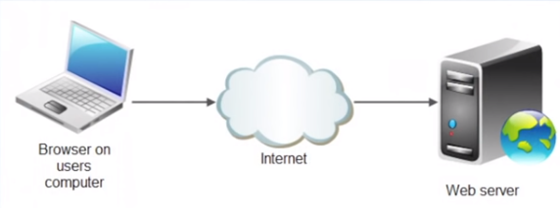
HTTP is based on client server model

Slide 4
Proporties of HTTP
Connectionless
The HTTP can deliver any sort of data, as long as the two computers are able to read it
Stateless

Slide 5
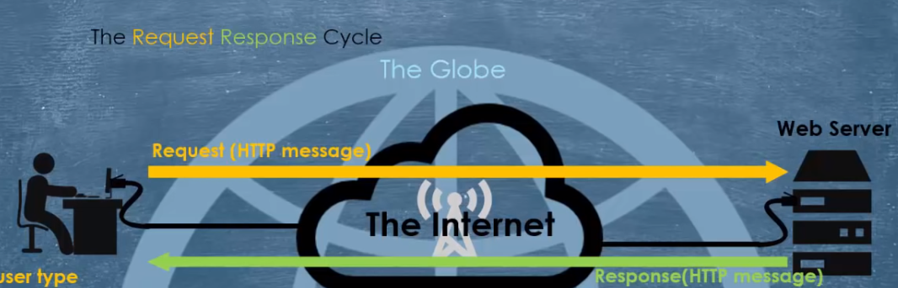
Working mechanism: -Connection is made -message is sent -get response

Slide 6
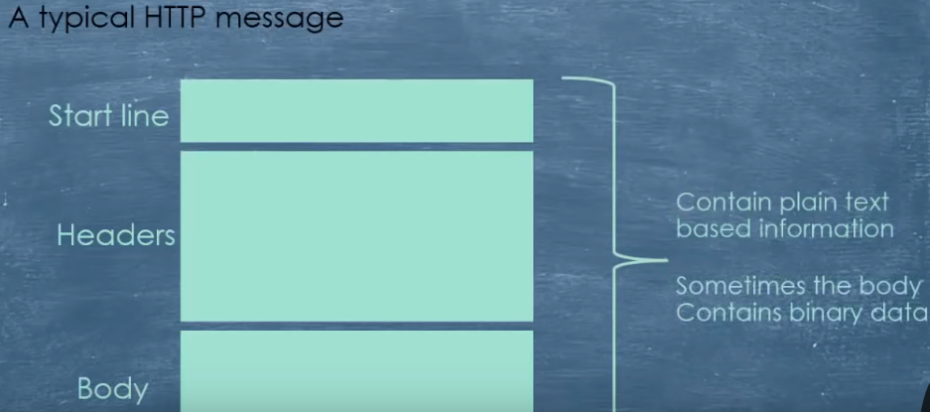

Slide 7
